Slide 1
Chapter 19
Remote Access Security

Slide 2
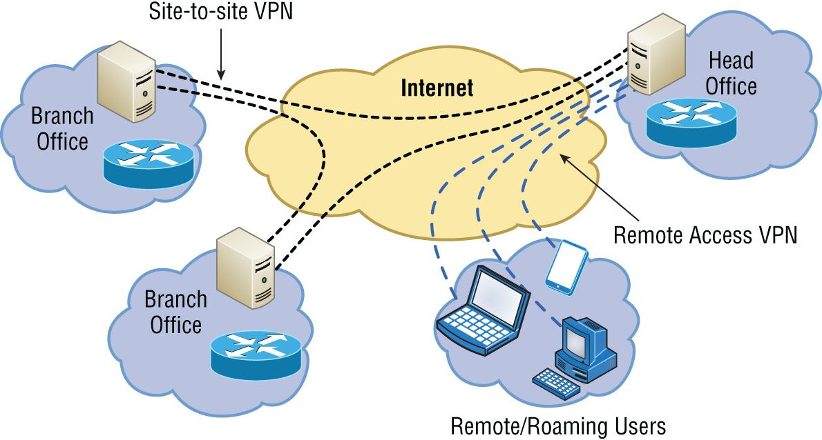
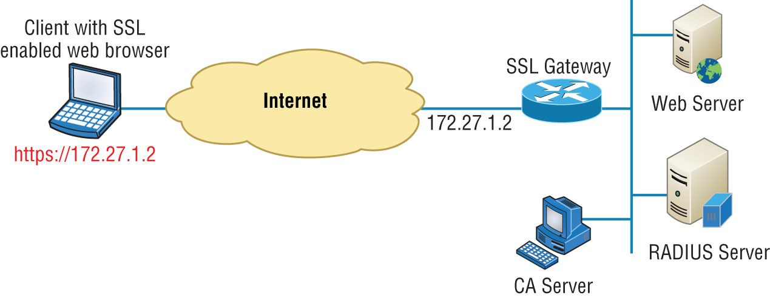
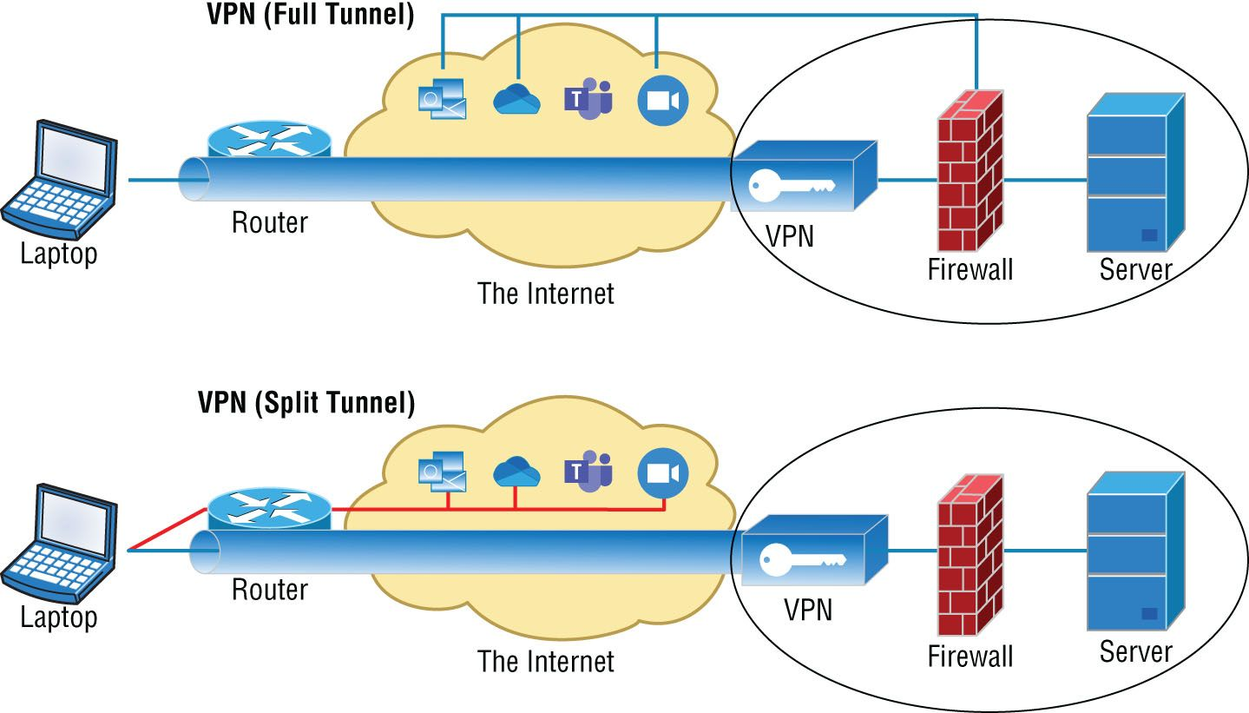
Site-to-site VPN
Client-to-site VPN
Clientless VPN
Split tunnel vs. full tunnel
Notes:
Site-to-site VPN: allows a company to connect its remote sites to the corporate backbone securely over the public network using encryption
Client-to-Site VPN: allows remote users to securely access the corporate network whenever and wherever they need to
Clientless VPN: enables end users to securely access resources on the corporate network from anywhere using an SSL/TLS enabled web browser
Split Tunnel: using a secure VPN connection and an open connection to the internet
Only traffic that goes to the office goes through the VPN
Full Tunnel: all traffic goes through the VPN

Slide 3
Remote desktop connection
Remote desktop gateway
More secure version of RDP
Uses SSL to directly tunnel to the remote server
No need for a VPN
SSH
Virtual network computing (VNC)
Remote Desktop service for all systems
Includes
VNC Server: runs on the machine sharing its screen
VNC Client: runs on the machine that is receiving the shared screen
VNC protocol (RDP)
Notes:
RDP gateway: adding security to the connection to your RDP connection using Secure Socket Layer tunnel. The gateway acts as a proxy
SSH: an alternative and more secure command-based utility than Telnet
Provides integrity and confidentiality
VNC: Platform independent version of RDP

Slide 4
Virtual desktop
Delivering the desktop from a remote environment
Remote server or the cloud
Benefits
Less compute power required from users desktop
Consistent environment
Authentication and authorization considerations
AAA
In-band vs. out-of-band management
In-Band- Managing the servers from your Network
Out-of-band- Method to manage the Server not using the network\
Integrated Lights Out (iLO)
Embedded in HP server and functions out-of-the box
Complete access to server from anywhere via web browser or mobile app
Notes:
VDI: access to different desktops from a virtual machine without needing to install that OS on your actual device. Secure in the cloud because your connection to this service is encrypted
AAA: When using remote access you need far more security, not less
Access rights should be limited
Out-of-band management: No access to the network, you can access it through the management port/interface

